Slide 1


{{PROPERTY_TYPE}} FOR LEASE
{{PROPERTY_NAME}}
{{PROPERTY_ADDRESS}}
PRIME PHILIPPINES 2026

Slide 2

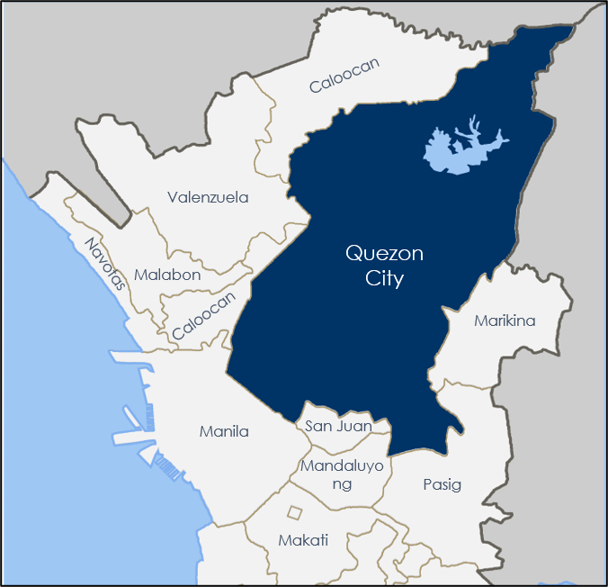
ECONOMIC HIGHLIGHTS IN QUEZON CITY
Competitive City Ranking:
Based on the 2024 Cities and Municipalities Competitiveness Index (CMCI), Quezon City ranked as the 2nd Overall Most Competitive Highly Urbanized City in the Philippines, with a total score of 69.79.
Brgy. Commonwealth
Rank 2nd
Most Populous Barangay
215,035
Population
Source: CMCI
Source: (PSA, 2024)
3,084,270
18,987/km²
161.11 km²
Total Population
Population Density
Total Land Area
Source: PSA, 2024
Source: City Population, 2024
Source: PhilAtlas
₱1.33 Trillion
142
National GDP of Quezon City
Number of Barangays
Source: PSA, 2024
Source: PSA, 2024
QUEZON CITY IS A LANDLOCKED HIGHLY URBANIZED CITY IN THE NATIONAL CAPITAL REGION WITH LAND AREA OF 171.71 SQUARE KILOMETERS OR 66.30 SQUARE MILES, MAKING IT THE LARGEST CITY IN METRO MANILA IN TERMS OF LAND AREA. MOREOVER, ITS POPULATION REPRESENTS 22.03% OF THE TOTAL POPULATION OF THE NATIONAL CAPITAL REGION.
Income Classification:
4.2%
1st Income Class City
Population Growth Rate
Classified as Special City and a Highly Urbanized City
Source: City Population, 2020-2024
Source: PSA, 2024
Source PRIME Philippines Research & Advisory, 2025

Slide 3


{{PROPERTY_NAME}}
{{LEASABLE_AREA}} sqm
{{PROPERTY_ADDRESS}}
{{PROPERTY_PHOTO_1}}
Key Features
Lease Terms & Conditions | Lease Terms & Conditions
Rental Rates | {{RENTAL_RATES}}
Security Deposit | {{SECURITY_DEPOSIT}} months
Advance Rent | {{ADVANCE_RENT}} months
Escalation Rate | {{ESCALATION_RATE}}
Preffered Lease Term | {{LEASE_TERM}}

Slide 4
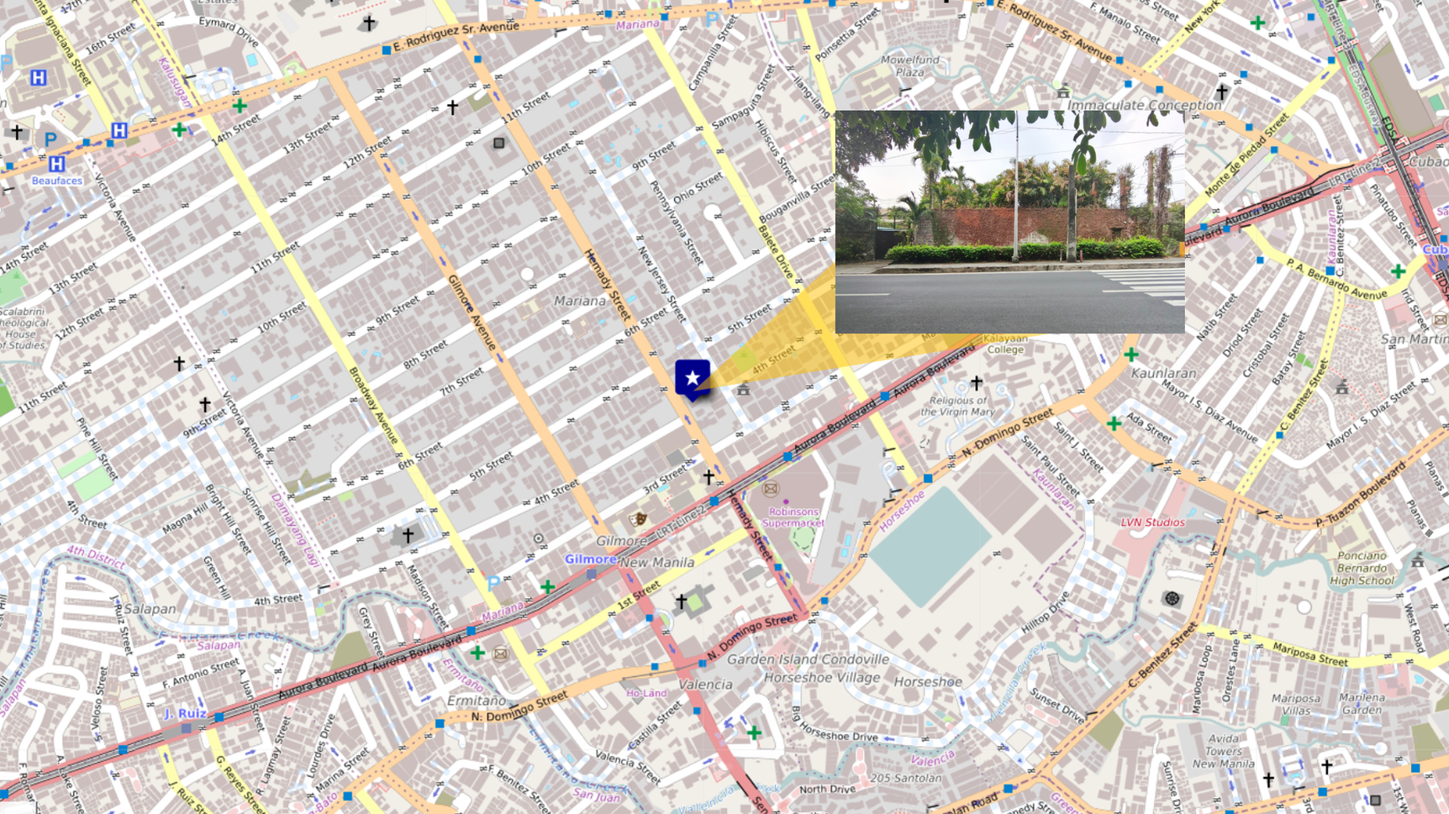

VICINITY OVERVIEW

Slide 5
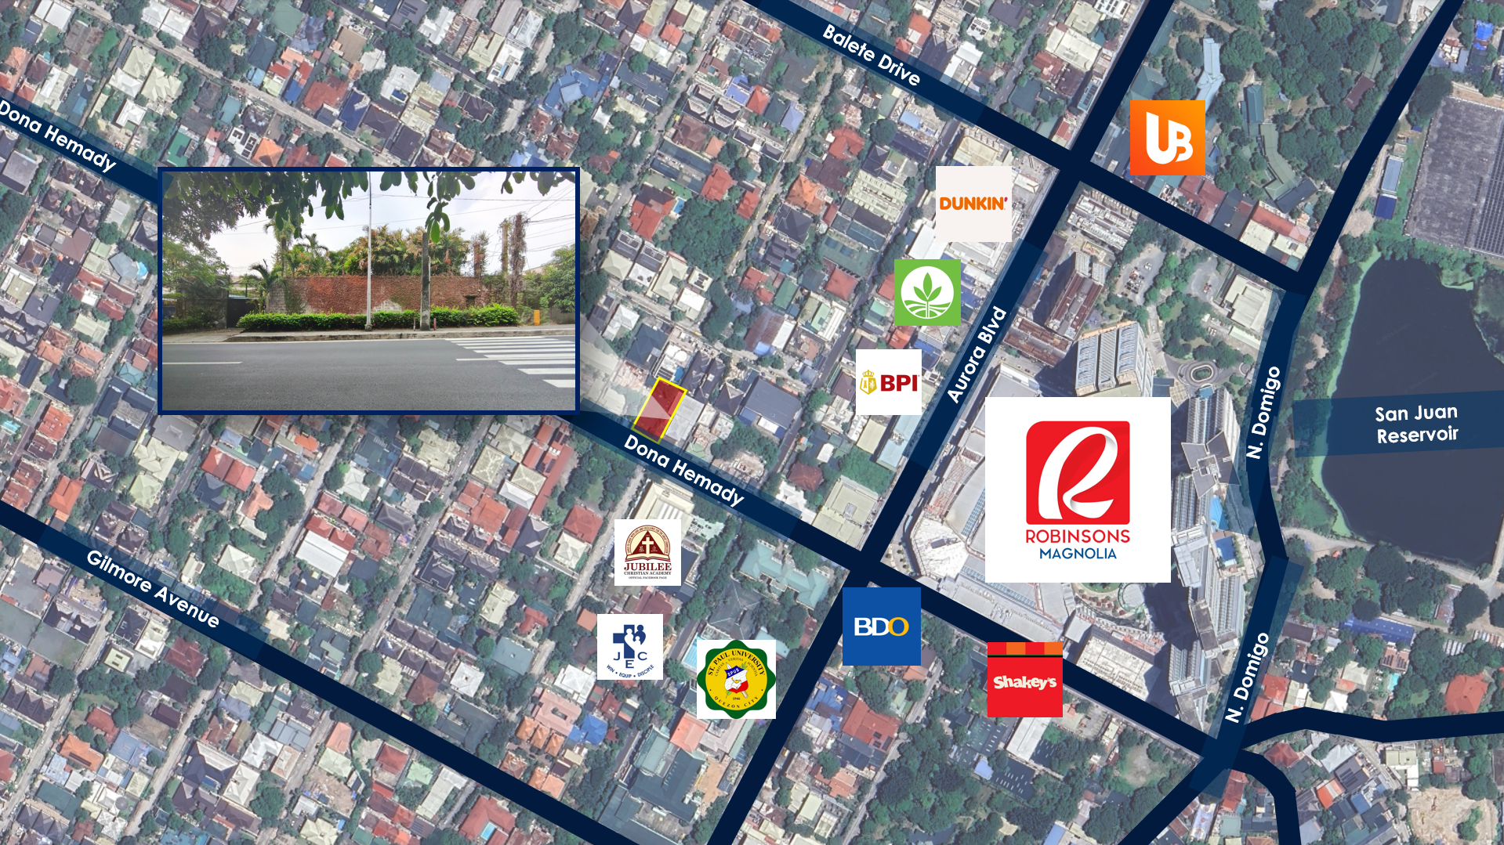
PROPERTY LOCATION & VICINITY MAP

Slide 6
{{PROPERTY_NAME}}
Demographics
PRIME PHILIPPINES 2026

Slide 7
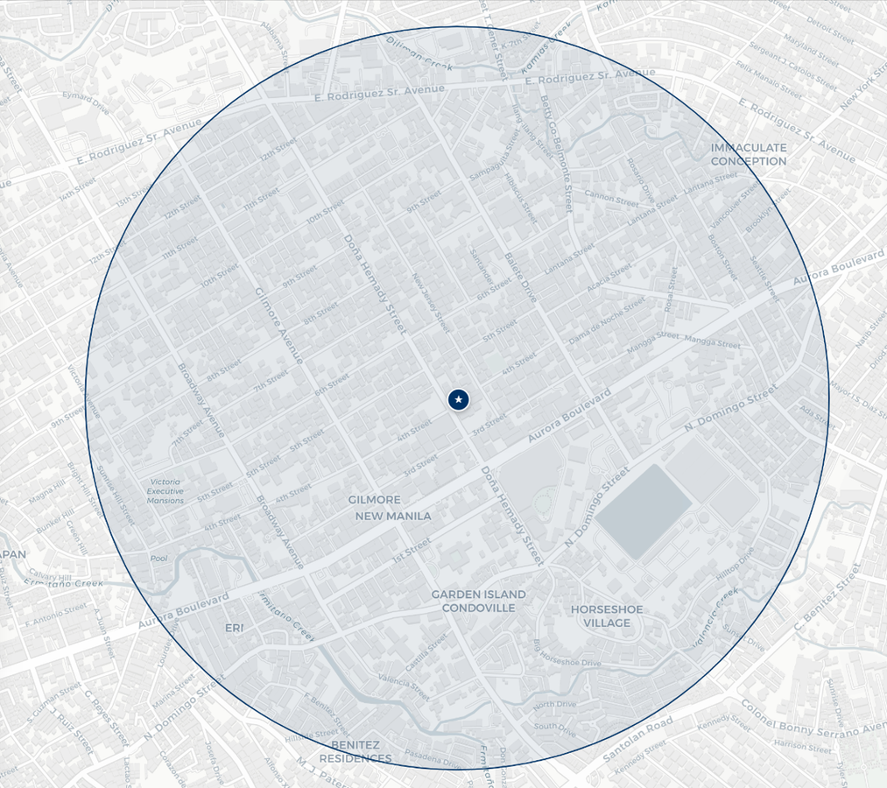
DEMOGRAPHICS

Slide 8
ACTUAL PHOTOS
{{PROPERTY_NAME}}
{{PROPERTY_PHOTO_1}}
{{PROPERTY_PHOTO_2}}
{{PROPERTY_PHOTO_3}}

Slide 9
FLOOR PLAN
{{PROPERTY_NAME}}
{{FLOOR_PLAN}}

Slide 10
LOT PLAN
{{PROPERTY_NAME}}
{{LOT_PLAN}}

Slide 11

For more information and to schedule a viewing contact us at:
MR. SONDI TUAZON
Sr. Head – Retail and Industrial Markets
(+63) 917 843 6128
sondi.tuazon@primephilippines.com
sondi.primecorp@gmail.com
OFFICE LOCATIONS
Manila
32/F SM Megatower, EDSA, corner Doña Julia Vargas Ave, Mandaluyong City Metro Manila
Cebu
Fifth Floor, Park Centrale, Cebu I.T. Park Jose Maria del Mar Street, Cebu City 6000
Davao
Fourth Floor, Topaz Tower,Damosa I.T. Park, J.P. Laurel Avenue, Lanang, Davao City 8000

Slide 12
PRIME PHILIPPINES • EST. 2013
Real Estate. We Advise. You Advance.
MANILA • CEBU • DAVAO

